Slide 1
Fast STA Graph Partitioning Framework for Multi-GPU Acceleration
Guannan Guo
Department of Electrical and Computer Engineering
University of Illinois at Urbana-Champaign, IL, USA
Tsung-Wei Huang
Department of Electrical and Computer Engineering
University of Utah, Salt Lake City, UT, USA
Martin Wong
Department of Computer Science and Engineering
The Chinese University of Hong Kong, Shatin, NT, Hong Kong
Presenter : Min-Feng Hsieh
Adviser : Ting-Chi Wang

Slide 2
Outline
Abstract
Introduction
Proposed Partitioning Framework For Multi-GPU Acceleration
Experimental Result
Conclusion

Slide 3
Outline
Abstract
Introduction
Proposed Partitioning Framework For Multi-GPU Acceleration
Experimental Result
Conclusion

Slide 4
Abstract
Path-based Analysis (PBA) is a key process in Static Timing Analysis (STA) to reduce excessive slack pessimism (Graph Based Analysis, GBA).
However, PBA can easily become the major performance bottleneck due to its long execution time.
To overcome this bottleneck, recent STA researches have proposed to accelerate PBA algorithms with manycore CPU and GPU parallelisms.
In this work, we introduce a new, fast endpoint-oriented partitioning framework that can separate STA graphs and dispatch the PBA workload onto multiple GPUs.
Notes:
However, GPU memory is rather limited when we compute PBA on large industrial designs with millions of gates. So a natural solution is to partition the circuit graph to reduce space complexity

Slide 5
Outline
Abstract
Introduction
Proposed Partitioning Framework For Multi-GPU Acceleration
Experimental Result
Conclusion

Slide 6
Introduction
This framework can quickly process the STA graph and build an end-point graph, which reflects the size of shared logic between endpoints
It takes linear time to construct an endpoint graph.
Endpoints with larger shared logic are grouped together in the same partition, which allows us to propagate shared timing information in a single partition.
If there exists shared logic across different partitions, we make minimal duplications to ensure we can conduct independent analysis.
Then they will separate the endpoint graph into groups and recover the partitions
Use the method of Karlsruhe high quality partitioning graph partitioning
Recover the full partitions by a linear recovery process

Slide 7
Introduction
Also with GPU manager, they can accelerate the PBA process on multiple GPUs
We associate one CPU core to monitor the execution status of one GPU device
We also leverage the work-stealing scheduler to move the imbalance analysis

Slide 8
Outline
Abstract
Introduction
Proposed Partitioning Framework For Multi-GPU Acceleration
Experimental Result
Conclusion

Slide 9
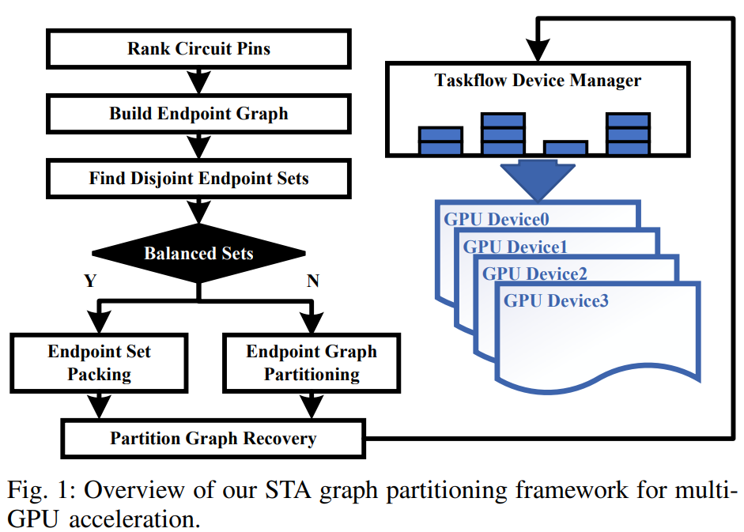
Partitioning Framework For Multi-GPU Acceleration
Step 1. Rank Circuit Pins
Process the circuit graph by ranking the circuit pins based on their distances from the source pins.

Slide 10
Proposed Partitioning Framework For Multi-GPU Acceleration
Step 2. Build Endpoint Graph
The endpoint graph can reflect the size of common logic between endpoints.

Slide 11
Proposed Partitioning Framework For Multi-GPU Acceleration
Step 3. Find Disjoint Endpoint Sets
Based on the endpoint graph, we identify independent components, which is represented by a set of endpoints

Slide 12
Proposed Partitioning Framework For Multi-GPU Acceleration
Step 4. Determine whether the sets are balanced
If the size of these disjoint sets are balanced, we can just pack them together
If the size of these disjoint sets are unbalanced, they will use the method of METIS graph partition to separate the endpoint graph

Slide 13
Proposed Partitioning Framework For Multi-GPU Acceleration
Step 5. Partition Graph Recovery
Use the method of linear BFS algorithm
Leverage a multithread library, Taskflow, to offload and monitor the PBA workloads of all partitions on multiple GPU devices

Slide 14
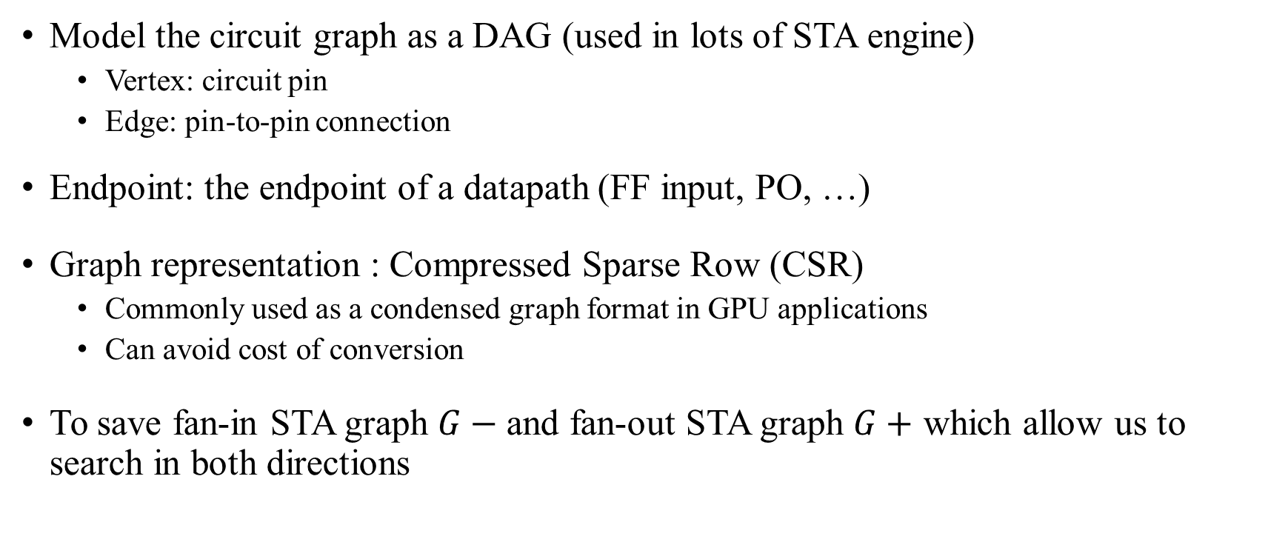
Proposed Partitioning Framework For Multi-GPU Acceleration – STA Graph Model
Model the circuit graph as a DAG (used in lots of STA engine)
Vertex: circuit pin
Edge: pin-to-pin connection
Endpoint: the endpoint of a datapath (FF input, PO, …)
Graph representation : Compressed Sparse Row (CSR)
Commonly used as a condensed graph format in GPU applications
Can avoid cost of conversion
To save fan-in STA graph $G−$and fan-out STA graph $G+$ which allow us to search in both directions
Notes:
CSR format contain three linear array, which holds:
Vertex offset
Edge destinations
Edge weights

Slide 15

Flow 1 – Circuit Pin Ranking
To estimate the size of shared logic, we use the minimum distance of each vertex to the source pins, denoted as $ranks$.

Slide 16
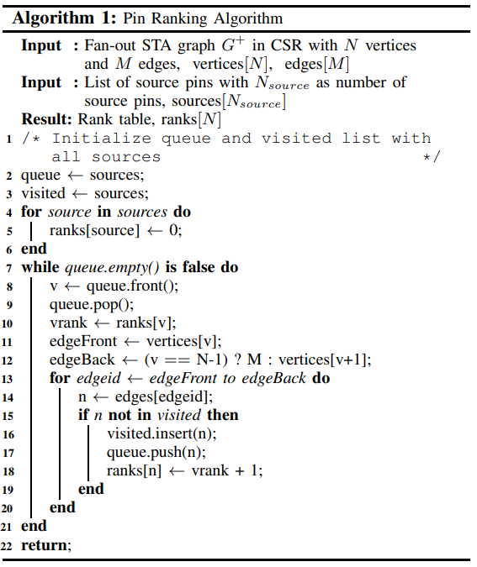

Initialize queue and visited
Set the rank of source to 0
Explore all the neighbor vertices in BFS

Slide 17
Example : Circuit Pin Ranking
0 1 0 0
0 0 0 0
1 1 0 0
0 1 1 0
0
1
2
3

Slide 18
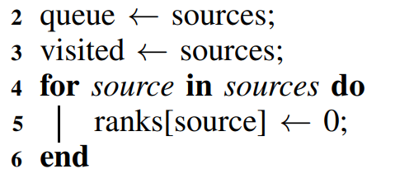
Example : Circuit Pin Ranking
0 1 0 0
0 0 0 0
1 1 0 0
0 1 1 0
queue | {3}
visited | {3}
Data (Weight) = [ 1 1 1 1 1 ]
Indices (Edge-destination) = [ 1 0 1 1 2 ]
Ptr (Vertex-offset) = [ 0 1 1 3 5 ]
Rank(3) | 0

Slide 19
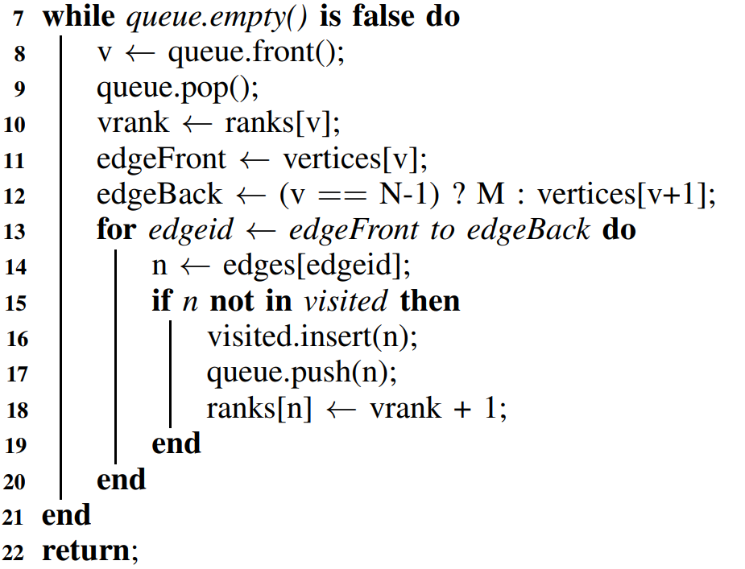
Circuit Pin Ranking (1)
Data (Weight) = [ 1 1 1 1 1 ]
Indices (Edge-destination) = [ 1 0 1 1 2 ]
Ptr (Vertex-offset) = [ 0 1 1 3 5 ]
queue | {1, 2}
visited | {1, 2, 3}
v = 3
vrank = 0
edgeFront = 3
edgeEnd = 5
edge = 3 → 1, 3 → 2
0
1
2
Rank(1) | 0+1=1
Rank(2) | 0+1=1
Rank(3) | 0
3

Slide 20
Circuit Pin Ranking (2)
Data (Weight) = [ 1 1 1 1 1 ]
Indices (Edge-destination) = [ 1 0 1 1 2 ]
Ptr (Vertex-offset) = [ 0 1 1 3 5 ]
queue | {2}
visited | {1, 2, 3}
v = 1
vrank = 1
edgeFront = 1
edgeEnd = 1
edge = X
0
1
2
Rank(1) | 1
Rank(2) | 1
Rank(3) | 0
3

Slide 21
Circuit Pin Ranking (3)
Data (Weight) = [ 1 1 1 1 1 ]
Indices (Edge-destination) = [ 1 0 1 1 2 ]
Ptr (Vertex-offset) = [ 0 1 1 3 5 ]
queue | {0}
visited | {0, 1, 2, 3}
v = 2
vrank = 1
edgeFront = 1
edgeEnd = 3
edge = 2 → 0, 2 → 1
0
1
2
Rank(0) | 1+1=2
Rank(1) | 1
Rank(2) | 1
Rank(3) | 0
3

Slide 22
Circuit Pin Ranking (4)
Data (Weight) = [ 1 1 1 1 1 ]
Indices (Edge-destination) = [ 1 0 1 1 2 ]
Ptr (Vertex-offset) = [ 0 1 1 3 5 ]
queue | {}
visited | {0, 1, 2, 3}
v = 0
vrank = 2
edgeFront = 0
edgeEnd = 1
edge = 0 → 1
0
1
2
Rank(0) | 1+1=2
Rank(1) | 1
Rank(2) | 1
Rank(3) | 0
3

Slide 23
Circuit Pin Ranking (final)
Rank = 2
Rank = 1
Rank = 1
0
1
2
Rank(0) | 1+1=2
Rank(1) | 1
Rank(2) | 1
Rank(3) | 0
3
Rank = 0

Slide 24
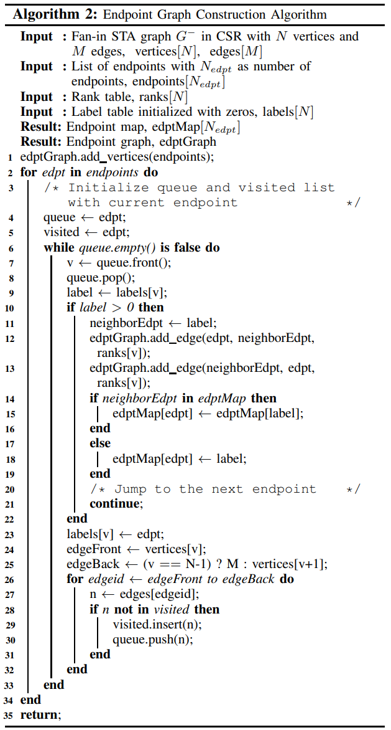
Flow. 2 – Endpoint Graph Construction
Construct endpoint graph
Compute the disjoint sets by merging the labels
Find fan-in logic cones

Slide 25
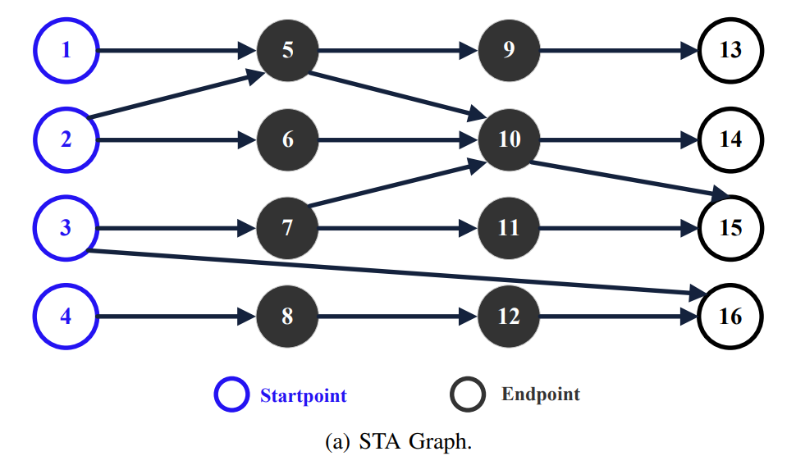
Example : Endpoint Graph Construction
edptGraph | vertex | {13, 14, 15, 16}
 | edge | {}

Slide 26
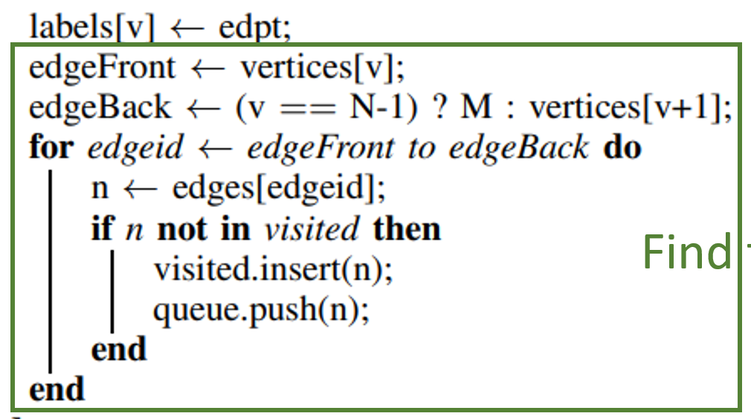
Endpoint Graph Construction (1)
v = 13
labels = 0
edptGraph | vertex | {13, 14, 15, 16}
 | edge | {}
labels[13] = 0 ->13
labels[9] = 0 -> 13
labels[5] = 0 -> 13
labels[1] = 0 -> 13
labels[2] = 0 -> 13
queue | {13} -> {9} -> {5} -> {1, 2} -> {}
visited | {13} -> {9, 13} -> {5, 9, 13} -> {1, 2, 5, 9, 13}

Slide 27
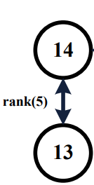
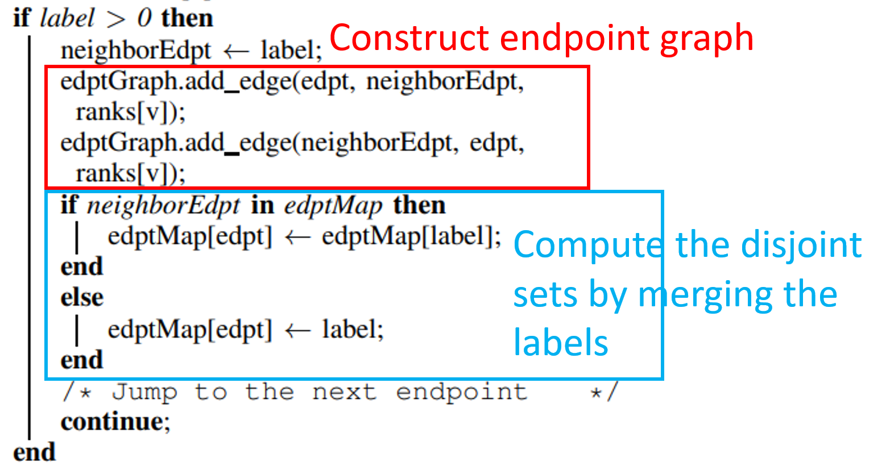
Endpoint Graph Construction (2)
13
13
13
13
13
edptGraph | vertex | {13, 14, 15, 16}
 | edge | {} -> {13<=>14}
v = 14
labels = 0
edptMap [14] | {} -> {13}
labels[14] = 0 -> 14
labels[10] = 0 -> 14
labels[5] = 13
Continue
4 label[6] = 14
5. label[2] = 14
6. label[7] = 14
7. label[3] = 14
neighborEdpt = 13
The weight = rank[5]
queue | {14} -> {10} -> {5, 6, 7}
Visited | {14} -> {10, 14}
Notes:
6 往前BFS會發現x已經visited

Slide 28
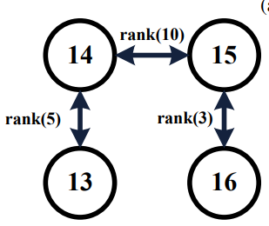
Endpoint Graph Construction (3)
13
13
13
13
13
14
14
14
14
14
edptGraph | vertex | {13, 14, 15, 16}
 | edge | {13<=>14} -> {13<=>14, 14<=>15}
v = 15
labels = 0
edptMap [14] | {13}
edptMap [15] | {13}
labels[15] = 0 -> 15
labels[10] = 14
continue
3. labels[11] = 0 -> 15
4. labels[7] = 14
5. labels[3] = 14
neighborEdpt = 14
The weight = rank[10]
queue | {15} -> {10, 11} -> {11} -> {7} -> {3}
Visited | {15} -> {10, 15} -> …

Slide 29
Endpoint Graph Construction (4)
13
13
13
13
13
14
14
14
14
14
15
15
edptGraph | vertex | {13, 14, 15, 16}
 | edge | {13<=>14} -> {13<=>14, 14<=>15} ->{13<=>14, 14<=>15, 15 <=>16}
v = 16
labels = 0
labels[16] = 0 -> 16
labels[3] = 14
continue
3. labels[12] = 0 -> 16
4. labels[8] = 0 -> 16
5. labels[4] = 0 -> 16
edptMap [14] | {13}
edptMap [15] | {13}
edptMap [16] | {13}
neighborEdpt = 15
The weight = rank[3]
queue | {16} -> {3, 12} -> {12} -> {8} -> {4}
Visited | {16} -> {3,16} -> …

Slide 30
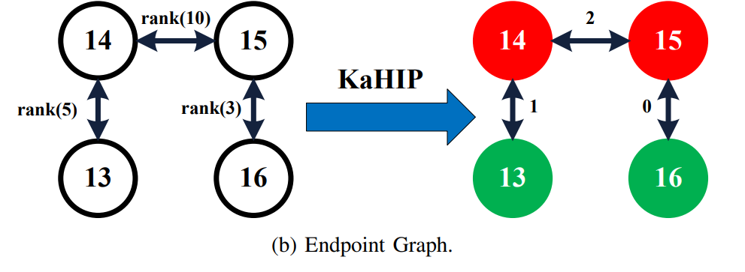
Endpoint Graph Construction (final)
13
13
13
13
edptGraph | vertex | {13, 14, 15, 16}
 | edge | {13<=>14} -> {13<=>14, 14<=>15} ->{13<=>14, 14<=>15, 15 <=>16}
13
14
14
14
14
14
15
15
16
16
16
16
edptMap [14] | {13}
edptMap [15] | {13}
edptMap [16] | {13}

Slide 31
Flow 3 – Endpoint Graph Partitioning and Recovering
Assume we want to partition the endpoint graph into 2
Notes:
Since endpoints 14 and 15 are connected with the highest weight

Slide 32
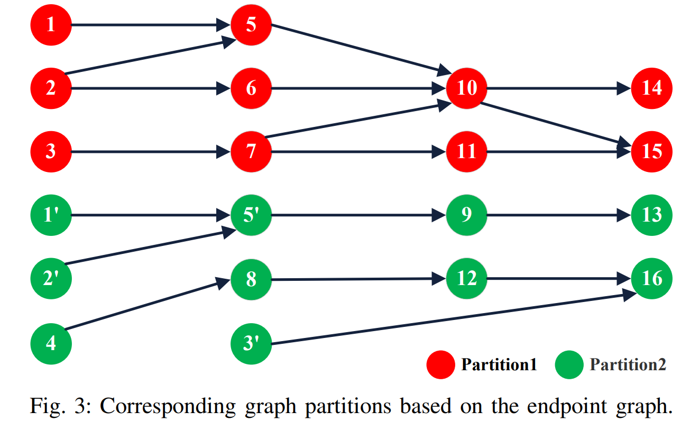
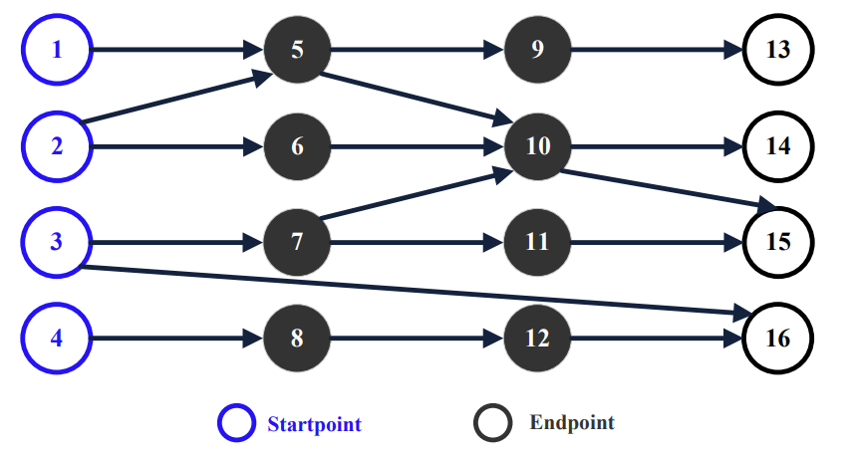








Flow 3 – Endpoint Graph Partitioning and Recovering
Perform BFS to obtain the entire fan-in cone with setting each endpoint of a group as root
Notes:
Since endpoints 14 and 15 are connected with the highest weight
These replicated vertices or pins are the cost of the framework, but
After replication, we can run PBA on these partitions as independent tasks on the GPU

Slide 33
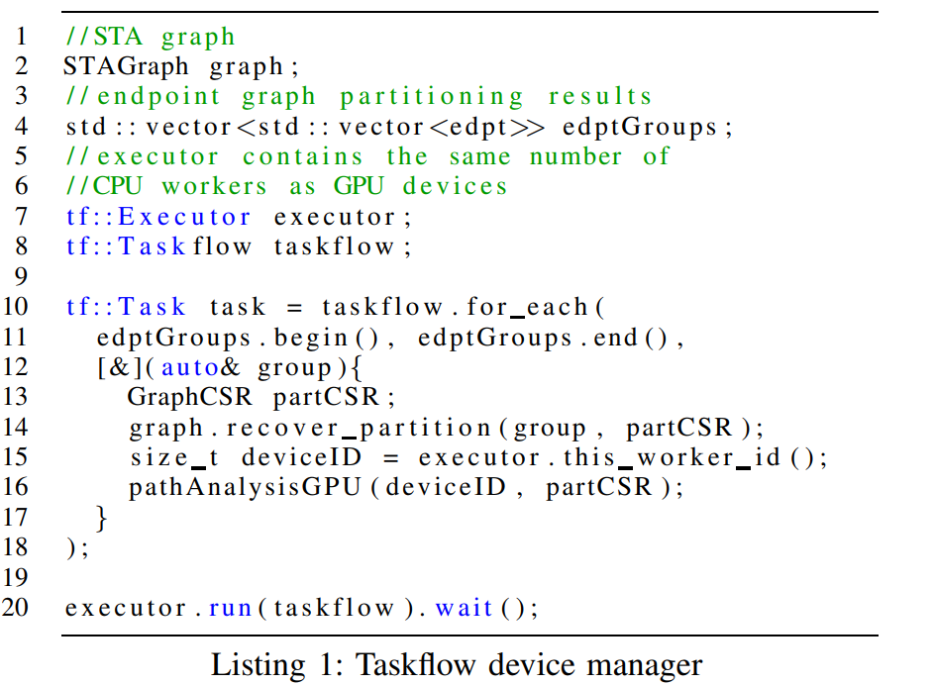
Flow 4 - Taskflow Device Management
We set the number of CPU worker threads the same as the number of GPU devices.
Each worker thread monitors execution of PBA on each partition
Wrap each group of endpoints into a task
Recover the full CSR graph format
from the endpoint group
Launch the PBA workload of the partition with corresponding worker index
Notes:
Inside each PBA execution, we use cudaSetDevice on this index to select the correct GPU device
In the end, we wait for executor to complete all the tasks (line 20).

Slide 34
Outline
Abstract
Introduction
Proposed Partitioning Framework For Multi-GPU Acceleration
Experimental Result
Conclusion

Slide 35
Experimental Result
64-bit Ubuntu Linux machine
Four GeForce RTX 2080 GPUs.
Four 2GHz Intel Xeon Gold 6138 CPU cores.
Compile our device code with CUDA NVCC 11.0
Host code with GNU GCC 8.3.0. and use optimization flag -O3 and C++17 standard -std=c++17.
Baseline algorithm is utilized in the open-sourced STAtool, OpenTimer.
Run the CPU baseline on a 3.2GHz Intel i5-4670 CPU core
The designs that have more than 10 million gates

Slide 36
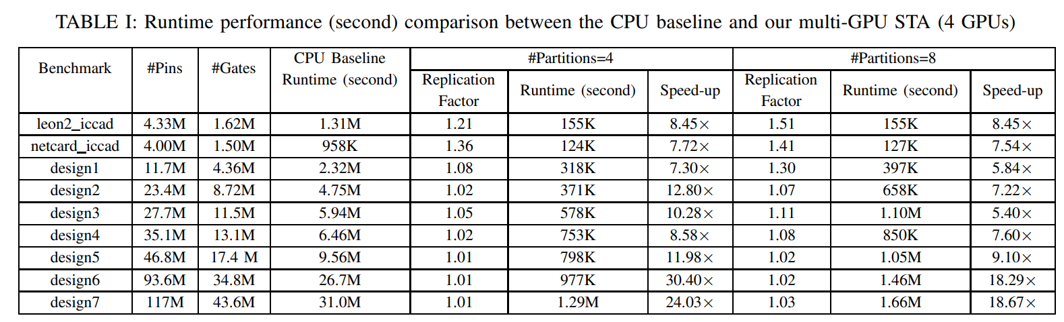
Experimental Result - Runtime
Notes:
Report 100K critical paths.
Does not induce any loss of accuracy compared to the baseline.
8 partition take majority of runtime in graph partition
沒有一個Pin會replicate 超過一次 (4-8 partition)

Slide 37
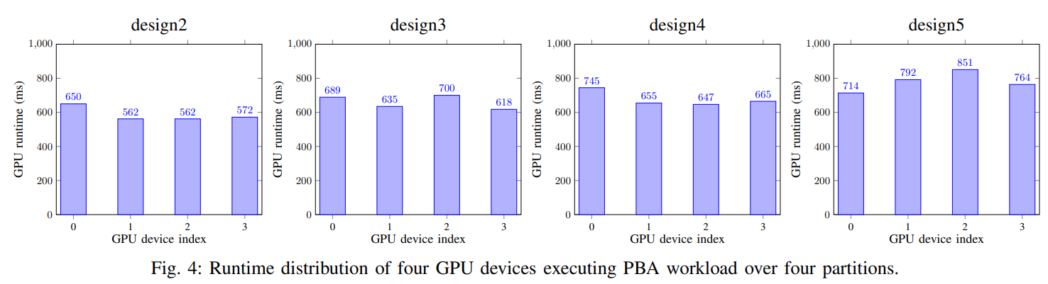
Experimental Result – Partition Quality
15.7%
13.2%
15.1%
19.2%

Slide 38
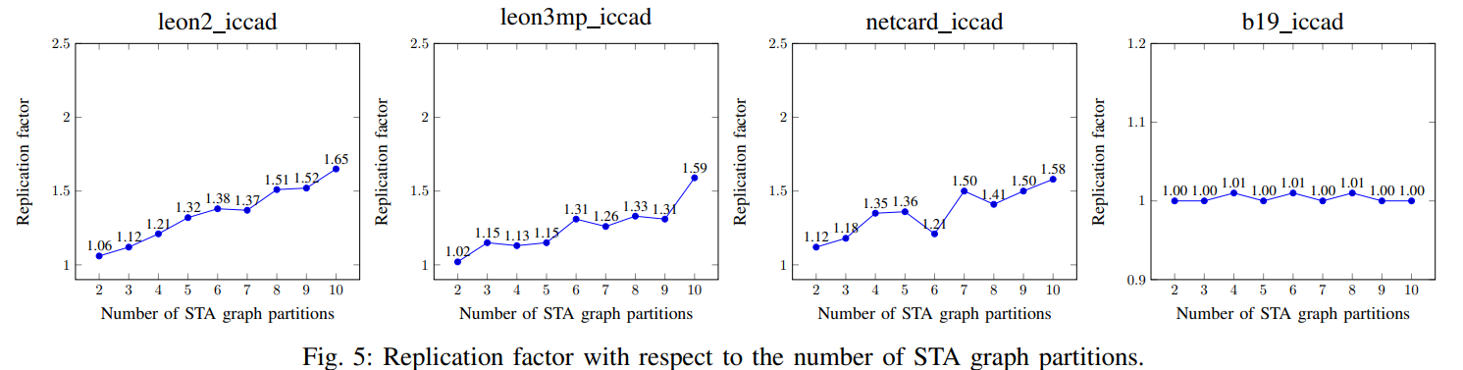
Experimental Result – Marginal Cost
Notes:
These 4 design are the largest and densest real design
Replication factor : average number of times that a ckt pin shows up in all partitions combined (就是平均每一個Pin會出現在幾個partition中)

Slide 39
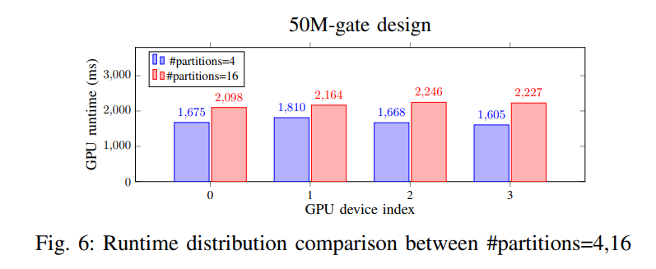
Experimental Result – Device Management and Workload Balancing
Notes:
Our Taskflow device manager balances the device workload when the number of partitions exceeds the number of devices.

Slide 40
Outline
Abstract
Introduction
Proposed Partitioning Framework For Multi-GPU Acceleration
Experimental Result
Conclusion

Slide 41
Conclusion
Obtain balanced graph partitions by separating an weighted endpoint graph.
Ensure the PBA workloads can execute on these partitions independently.
The framework can accelerate PBA by 12–24× for designs above 10M gates

Slide 42
Thank you for listening!

